Slide 1
web
<web design module=”3”>

Slide 2
web
<web design module=”3”>
Web Conventions
What are Conventions?

Slide 3
web
<web design module=”3”>
Web Conventions
What are Conventions?
The key to successful web design is not making your users think.

Slide 4
web
<web design module=”3”>
Web Conventions
What are Conventions?
The key to successful web design is not making your users think.
A great website is one that feels familiar the first time a user browses through.

Slide 5
web
<web design module=”3”>
Web Conventions
What are Conventions?
The key to successful web design is not making your users think.
A great website is one that feels familiar the first time a user browses through.
Web conventions are the similarities in websites that make this possible.

Slide 6
web
<web design module=”3”>
Web Conventions
Web Conventions have been properly applied when:
Navigating from page to page is effortless
Information is straightforward
Everything does what it’s expected to do
Users can find exactly what they’re looking for quickly and confidently.

Slide 7
web
<web design module=”3”>
Web Conventions
Web Conventions build on the knowledge that your users have acquired through years of browsing through websites.

Slide 8
web
<web design module=”3”>
Web Conventions
Web Conventions build on the knowledge that your users have acquired through years of browsing through websites.
They are your friends because they speak to your visitors in a language they can easily understand.

Slide 9
web
<web design module=”3”>
Web Conventions
Why adopt Conventions?

Slide 10
web
<web design module=”3”>
Web Conventions
Why adopt Conventions?
Because they work.

Slide 11
web
<web design module=”3”>
Web Conventions
Why adopt Conventions?
Because they work.
Conventions only become conventions if users find them useful.

Slide 12
web
<web design module=”3”>
Web Conventions
Why adopt Conventions?
If one site has success because it has decided to use a particular style of navigation, another site may pick up on this and adopt a similar style.
The more this happens the faster users“learn” how to manoeuvre from site to site.

Slide 13
web
<web design module=”3”>
Web Conventions
Why adopt Conventions?
Reassuring users and providing a familiar environment to browse can go a long way in instilling confidence and trust for your brand.

Slide 14
web
<web design module=”3”>
Web Conventions
Why adopt Conventions?
Conventions can help convey information even if you can’t understand a single word on the page.

Slide 15
web
<web design module=”3”>
Web Conventions
What are they?

Slide 16
web
<web design module=”3”>
Web Conventions
What are they?
Layout (Hierarchy)
Navigation
Links & Buttons
Fonts
Iconography
Naming

Slide 17
web
<web design module=”3”>
Web Conventions
Layout
The logos of most websites appear on the top left of the page and indicate exactly what site I am on. It is also common practice to make this logo a link to the home page of the site.

Slide 18
web
<web design module=”3”>
Web Conventions
Layout
Continuing down the page, convention says we need navigation of some sort.

Slide 19
web
<web design module=”3”>
Web Conventions
Layout
The next section (the ‘Hero section’) is where we expect to find a large image, banner slider or important content that will have information we need and will lead us to the main purpose of the site.

Slide 20
web
<web design module=”3”>
Web Conventions
Layout
Many sites will use a sidebar on the left side of the page for navigation and related content.
In the blog community, however, a far greater number of sites put the sidebar on the right.

Slide 21
web
<web design module=”3”>
Web Conventions
Layout
At the bottom of the page we expect to find a footer with helpful links to privacy policies, copyright information, contact pages and a sitemap.
It is also the first place to look for a link to find out who designed the site.

Slide 22
web
<web design module=”3”>
Web Conventions
Navigation
Most primary navigation is organised horizontally across the top middle area of the page.

Slide 23
web
<web design module=”3”>
Web Conventions
Navigation
Vertical sidebar menus can also be used for main navigation although most sites will use this for secondary navigation.

Slide 24
web
<web design module=”3”>
Web Conventions
Navigation
Utilities, such as links to contact pages, user accounts, and other practical options appear as small text links at the top right of most websites.

Slide 25
web
<web design module=”3”>
Web Conventions
Navigation
Breadcrumb navigation helps users identify location on larger websites. These links almost always appear directly above the main content area.

Slide 26
web
<web design module=”3”>
Web Conventions
Navigation
Footer navigation is generally reserved for privacy and legal links, contact information, and maybe a sitemap. Large, more useful footers are growing in popularity which change how users may search for popular pages, social network links, etc.

Slide 27
web
<web design module=”3”>
Web Conventions
Links & Buttons
A classic link is blue text with an underline.
Visited links become purple.

Slide 28
web
<web design module=”3”>
Web Conventions
Links & Buttons
Buttons much like links have become obvious because of their “pressable” appearance. Conventional web buttons may be rounded and coloured with a text-effect or bevel to indicate interaction.

Slide 29
web
<web design module=”3”>
Web Conventions
Links & Buttons
Hover states for links and buttons, or the pointer becoming different, are also signs that something will happen upon a click.

Slide 30
web
<web design module=”3”>
Web Conventions
Fonts
Particular fonts are repeated from site to site because of their readability. Web-safe fonts are web-safe because they have been widely adopted across operating systems.

Slide 31
web
<web design module=”3”>
Web Conventions
Fonts
Particular fonts are repeated from site to site because of their readability. Web-safe fonts are web-safe because they have been widely adopted across operating systems.
Sans-Serif is generally used for web because of its readability.

Slide 32
web
<web design module=”3”>
Web Conventions
Iconography
The magnifying glass next to an input field indicates search, even if there are no words or text indicating ‘search’.
Any online shopper will understand the concept of a checkout process and shopping cart icon.

Slide 33
web
<web design module=”3”>
Web Conventions
Naming
Practically every site has a ‘Contact’ page or an ‘About’ page. And users have expectations about where these will take them, actions they can take and what information they will be given.

Slide 34
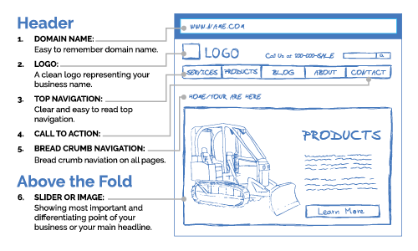
web
<web design module=”3”>

Slide 35
web
<web design module=”3”>
Web Conventions
Remember this:
Users like conventions and familiarity. Respect them.

Slide 36
Grids
web
<web design module=”3”>

Slide 37
The grid makes it possible to bring all the elements of design — type characters, photography, drawing and color — into a formal relationship to each other; that is to say, the grid system is a means to introducing order into a design. A deliberately composed design has a clearer, more neatly arranged and more successful effect than an advertisement put together at random.
- Josef Müller Brockmann
web
<web design module=”3”>

Slide 38
What is a grid?
web
<web design module=”3”>
A grid is made of one or more horizontal or vertical guides, that help you to arrange pictorial and textual elements on a page.
Grids vary in size and shape from simple to complex, depending on the range and amount of information you are going to place on a page. No matter how sophisticated or plain your grid is, it’s always constructed of the same elements.

Slide 39
Columns
Gutter
Columns
Vertical divisions of space, separated from each other by gutters. They are the main force, that help the designer to place visual elements across the page.

Slide 40
Margin
Margins
The negative space between the page’s edges and the active area of the content the directs the viewer toward the visual elements.
Used for the placement of subordinate elements such as page numbers.
The size of the margin depends on type, format and quality of visual information.

Slide 41
Flowline
Flowlines
Horizontal axes that break the space into horizontal divisions (or rows).
They provide an additional point of alignment and help to arrange elements across and down the page.

Slide 42
Grids establish a meter and rhythm
web
<web design module=”3”>
The foremost purpose of a grid – in graphic design at least – is to establish a set of guidelines for how elements should be positioned within a layout.
Not only does an effective grid provide the rhythm for a design, but it also defines the meter.

Slide 43
Grids define and reflect proportion
web
<web design module=”3”>
In print, proportions most commonly echo the size of the media; the shape and orientation of the paper are often reflected in the size and shape of images included within a layout.

Slide 44
Grids provide a solid foundation
web
<web design module=”3”>
Grids help to determine the positioning and balance in a layout. Providing this kind of firm foundation can help ensure content is presented in an easy-to-understand order.

Slide 45
Narrow
Manuscript Grid
2x
1x
Wide
Classic manuscript grids have wide margins at the bottom and the sides of the page and smaller at the top. Inner margins are typically half the size of the outer.
Ideal solution for presenting a large amount of continuous text.

Slide 46
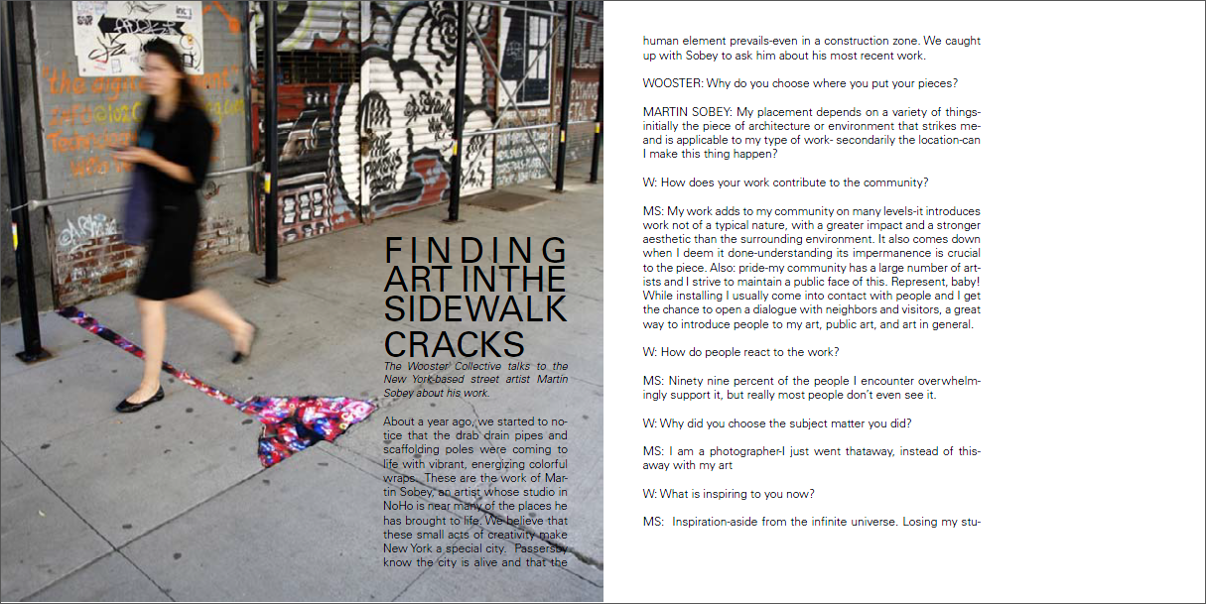

Slide 47
Column Grid
Multiple columns give you endless options for composition. It also helps you to maintain rhythm, movement, tension, balance and order.
Ideal solution for publications like articles, recipe books and magazine spreads.

Slide 48
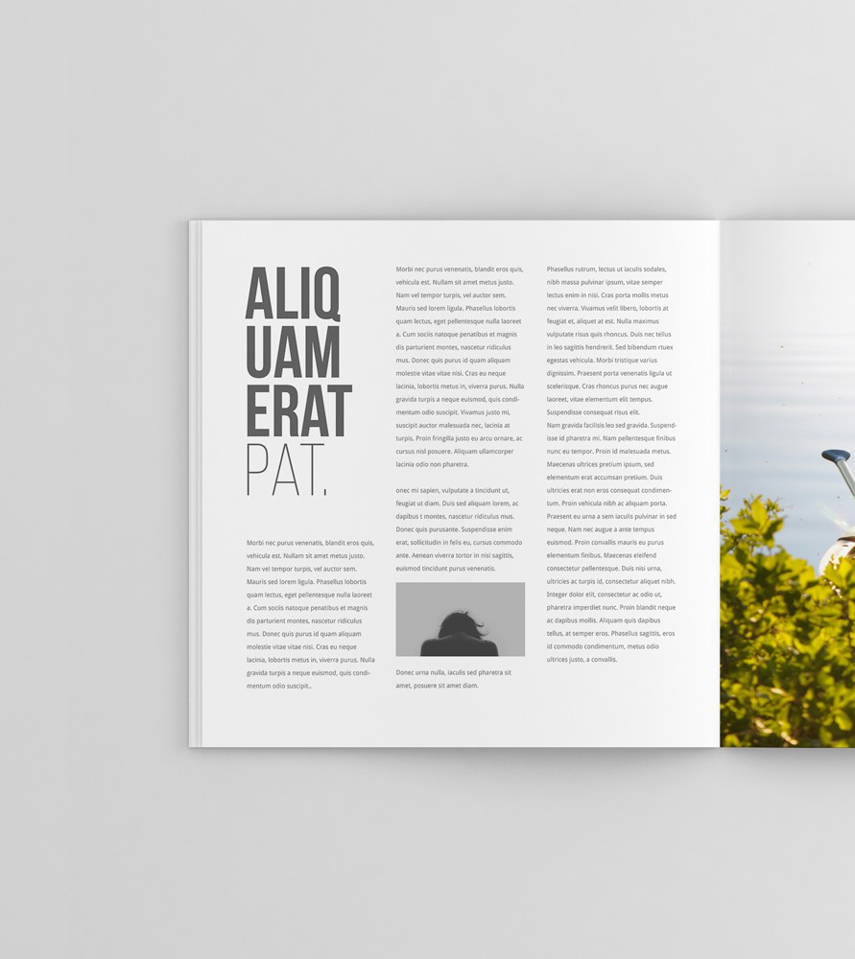
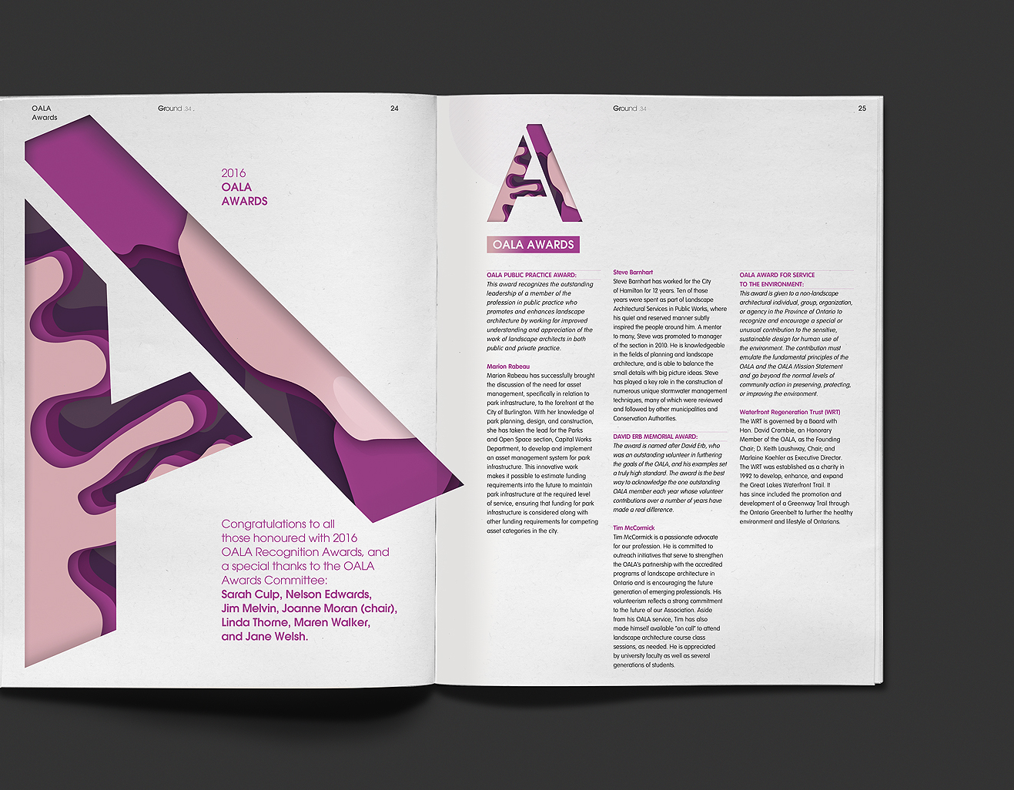

Slide 49
Modular Grid
A column and row grid that not only tells you the x-placements, but also guides on the y-axis.
Handy when you design with tabular information, like charts, forms, schedules, navigational systems. The rigorous pattern of modules helps to standardize data in a table.

Slide 50
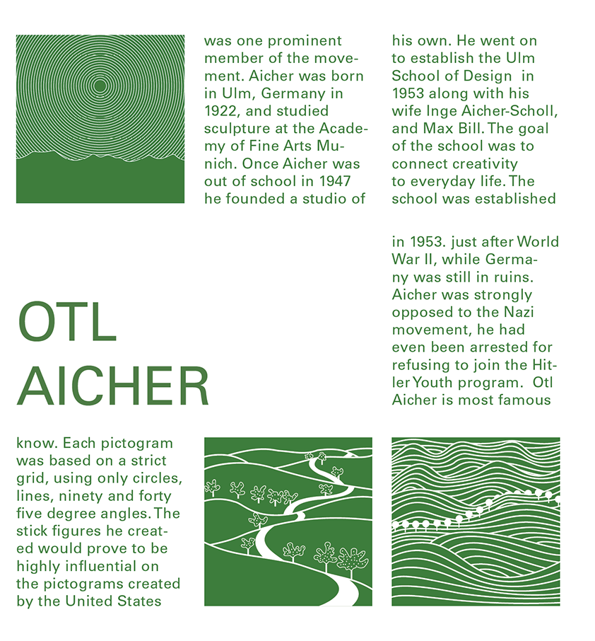
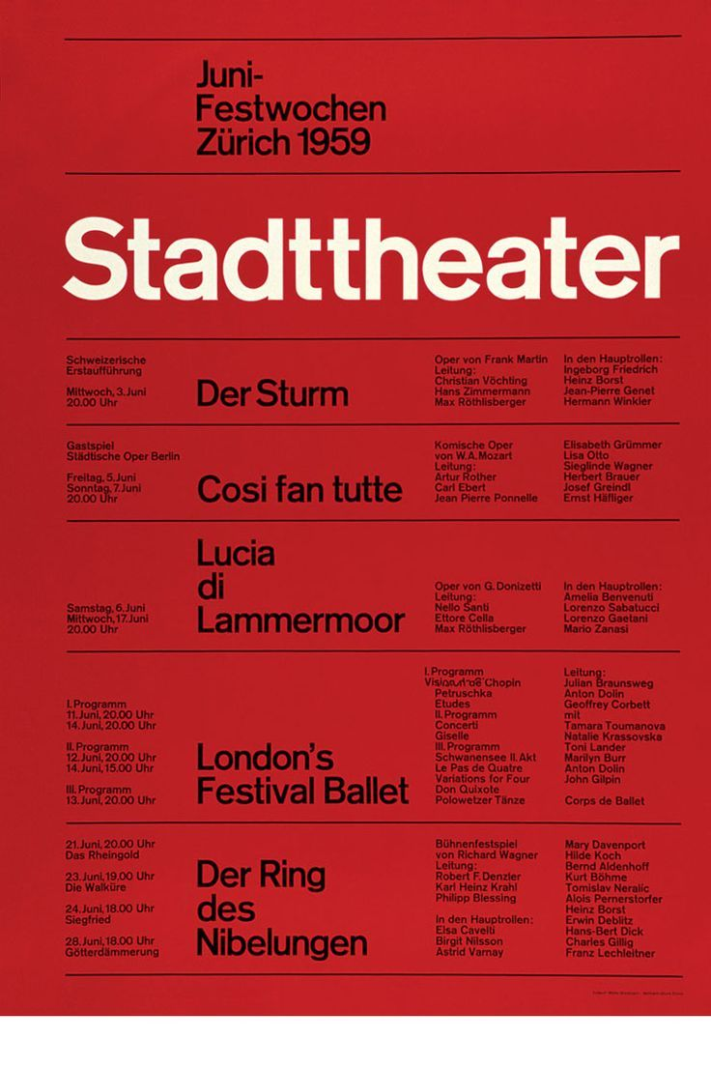

Slide 51
Baseline Grid
One way grids help enhance the legibility of your type is through something called the ‘baseline grid’.
These are narrow horizontal rows that run across your design that each line of your type sits on, a bit like the ruled lines in a notebook.
What these grid lines help you to do is align your bodies of type so that they each sit on the same level.

Slide 52
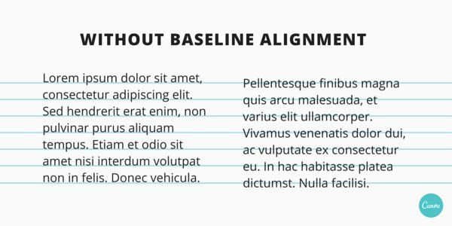

Slide 53
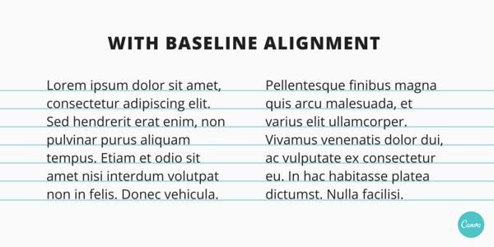

Slide 54
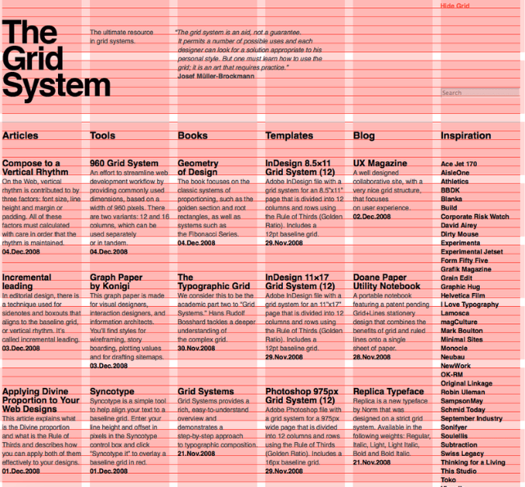

Slide 55
How To Use A Grid
Plan how the grid relates to its container
How a grid is positioned within the page (how the margins are set up) can have a big impact on how the grid performs, both functionally and aesthetically.

Slide 56
How To Use A Grid
web
<web design module=”3”>
Always begin and end elements in a grid field —not in the gutter
The gutter—the empty space between columns—should be used to separate elements.
Text and graphics can span multiple columns, of course–but they should begin and end at the edge of a column, not in the gutter.

Slide 57


Slide 58


Slide 59
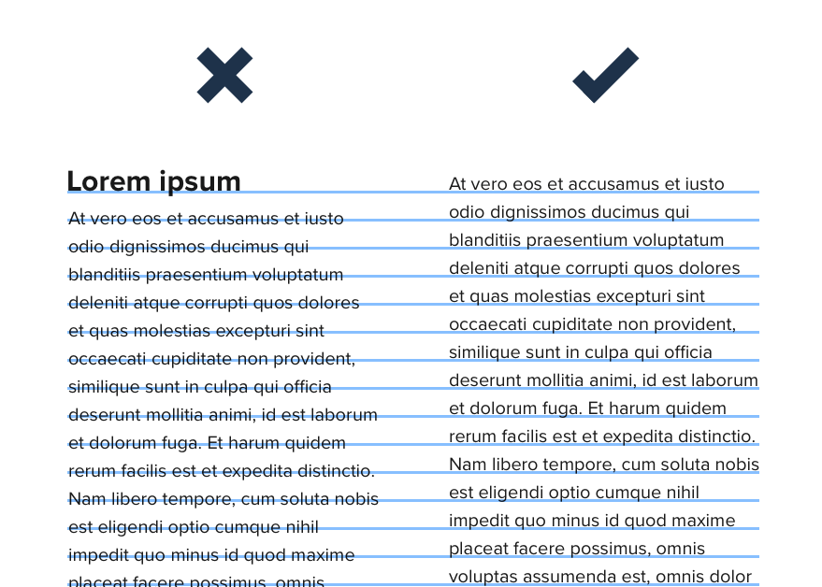
How To Use A Grid
Don’t forget about baseline alignment
Making sure that all the text in a column-based design also sticks to a consistent baseline can make a big difference to the sense of harmony and organisation in a page. Baseline alignment is often overlooked in web design—but with careful planning, it is possible to achieve.

Slide 60
Grids in Web
In Web Design, we use a 12 column grid.

Slide 61
12 Column Grids
web
<web design module=”3”>
Creates continuity between pages
Helps users predict where to find information
Makes it easier to add new content consistently
Helps designers and developers collaborate in a consistent way

Slide 62
web
<web design module=”3”>
Your Grid - Your Layout
Use the mini whiteboards and pens to create your layout for your recipe pages using a 12 column grid.

